Slide 1


Exposure Java 2013
APCS Edition
Chapter 11 Slides
Dynamic Arrays
with the ArrayList Class
PowerPoint Presentation
created by:
Mr. John L. M. Schram
and Mr. Leon Schram
Authors of Exposure Java

Slide 2
Section 11.1
Introduction

Slide 3
Java Arrays
• Java has a static array capable of multi-dimensions.
• Java has a dynamic array, which is also capable of multi-dimensions.
• The ArrayList class is used for the dynamic array.

Slide 4
Section 11.2
ArrayList
Methods

Slide 5
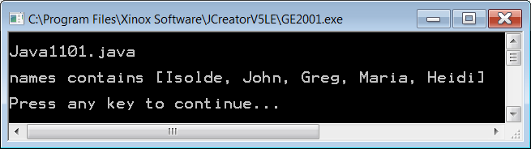
// Java1101.java
// This program demonstrates the <add> method of the <ArrayList> class.
// Note that each name is added to the end of the list.
import java.util.ArrayList;
public class Java1101
{
public static void main(String args[])
{
System.out.println();
System.out.println("Java1101.java\n");
ArrayList names = new ArrayList();
names.add("Isolde");
names.add("John");
names.add("Greg");
names.add("Maria");
names.add("Heidi");
System.out.println("names contains " + names);
System.out.println();
}
}

Slide 6
ArrayList Method add
names.add("Tom");
The add method allocates space for the newly enlarged array and then stores the new array element at the end of the ArrayList object.

Slide 7
Displaying ArrayList Elements
ArrayList elements can be accessed with various methods.
It is possible to display all the elements inside square brackets, separated by commas by using the print method.
System.out.println(names);
[Isolde, John, Greg, Maria, Heidi]

Slide 8
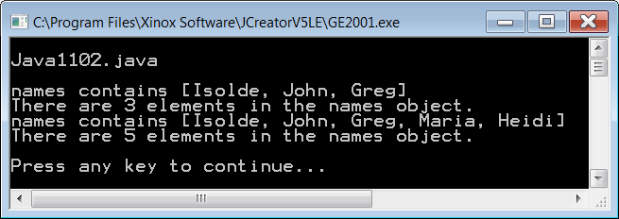
// Java1102.java
// This program uses the <size> method to determine the number of elements in an <ArrayList> object.
// Note that the value return by the <size> method changes when more names are added to the
// <ArrayList> object.
import java.util.ArrayList;
public class Java1102
{
public static void main(String args[])
{
System.out.println();
System.out.println("Java1102.java\n");
ArrayList names = new ArrayList();
names.add("Isolde");
names.add("John");
names.add("Greg");
System.out.println("names contains " + names);;
System.out.println("There are " + names.size() + " elements in the names object.");
names.add("Maria");
names.add("Heidi");
System.out.println("names contains " + names);
System.out.println("There are " + names.size() + " elements in the names object.");
System.out.println();
}
}

Slide 9
ArrayList Method size
int count = names.size();
The size method returns the number of elements of the ArrayList object names.
Remember Java static arrays use a length field while ArrayList uses a size method.
Don’t confuse
length & size!

Slide 10
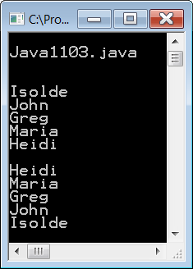
// Java1103.java
// This program shows how to access specified elements in an <ArrayList> object
// with the <get> method.
import java.util.ArrayList;
public class Java1103
{
public static void main(String args[])
{
System.out.println();
System.out.println("Java1103.java\n");
ArrayList names = new ArrayList();
names.add("Isolde");
names.add("John");
names.add("Greg");
names.add("Maria");
names.add("Heidi");
System.out.println();
for (int k = 0; k < names.size(); k++)
System.out.println(names.get(k));
System.out.println();
for (int k = names.size()-1; k >= 0; k--)
System.out.println(names.get(k));
System.out.println();
}
}

Slide 11
ArrayList Access
ArrayList objects cannot be accessed with an index [ ] operator, like a Java static array.
All access is performed with ArrayList methods.
ACCESS DENIED!

Slide 12
ArrayList Method get
System.out.println(names.get(3));
The get method accesses a specified array element.
The parameter of the get method is the index of the ArrayList object and starts at 0.
Any attempt to access an element at a
non-existing index results in an IndexOutOfBoundsException error.

Slide 13
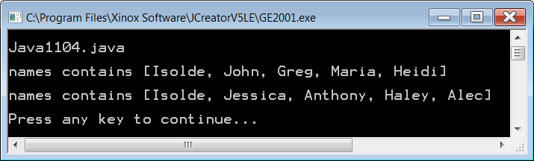
// Java1104.java
// This program demonstrates the <set> method of the <ArrayList> class, which
// replaces existing elements with a new object.
import java.util.ArrayList;
public class Java11104
{
public static void main(String args[])
{
System.out.println();
System.out.println("Java1104.java\n");
ArrayList names = new ArrayList();
names.add("Isolde");
names.add("John");
names.add("Greg");
names.add("Maria");
names.add("Heidi");
System.out.println("names contains " + names);
System.out.println();
names.set(1,"Jessica");
names.set(2,"Anthony");
names.set(3,"Haley");
names.set(4,"Alec");
System.out.println("names contains " + names);
System.out.println();
}
}

Slide 14
ArrayList Method set
names.set(4,"Tom");
The set method uses the first parameter as the index location to find an array element and then replaces it with the value of the second set parameter.
You will get an error if you try to access an index location, which has not been allocated yet.

Slide 15
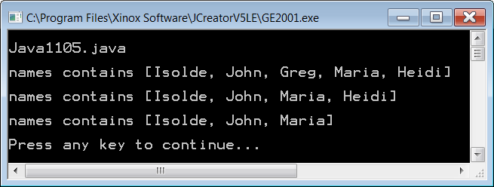
// Java1105.java
// This program demonstrates the <remove> method of the <ArrayList> class to
// delete a specified list element.
import java.util.ArrayList;
public class Java1105
{
public static void main(String args[])
{
System.out.println();
System.out.println("Java1105.java\n")
ArrayList names = new ArrayList();
names.add("Isolde");
names.add("John");
names.add("Greg");
names.add("Maria");
names.add("Heidi");
System.out.println("names contains " + names);
System.out.println();
names.remove(2);
System.out.println("names contains " + names);
System.out.println();
names.remove(3);
System.out.println("names contains " + names);
System.out.println();
}
}

Slide 16
ArrayList Method remove
names.remove(3);
The remove method removes the array element at the index location of its parameter and decreases the object size by one array element.
You will get an error if you try to access an index location, which does not exist.

Slide 17
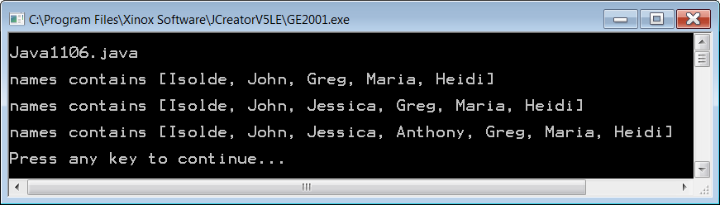
// Java1106.java
// This program demonstrates how to use the overloaded <add> method of the <ArrayList>
// class to insert new elements at a specified location.
import java.util.ArrayList;
public class Java1106
{
public static void main(String args[])
{
System.out.println();
System.out.println("Java1106.java\n");
ArrayList names = new ArrayList();
names.add("Isolde");
names.add("John");
names.add("Greg");
names.add("Maria");
names.add("Heidi");
System.out.println("names contains " + names);
System.out.println();
names.add(2,"Jessica");
System.out.println("names contains " + names);
System.out.println();
names.add(3,"Anthony");
System.out.println("names contains " + names);
System.out.println();
}
}

Slide 18
ArrayList Method add (2nd Overloaded method)
names.add(3,"Kathy");
The overloaded add(3,"Kathy") method adds or rather inserts a new array element at the indicated index.
As always, you will get an error if you try to access an index location, which does not exist.

Slide 19
AP Exam Alert
The ArrayList class is tested on the AP exam
with the following six methods:
int size()
boolean add(E obj)
void add(int index, E obj)
E get(int index)
E set(int index, E obj)
E remove(int index)
In the method headings above E is the data type of the Element that is added or returned.

Slide 20
Section 11.3
ArrayList
and Primative
Datatypes

Slide 21
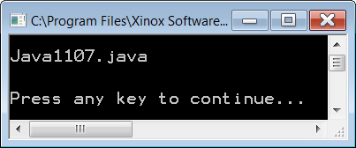
// Java1107.java
// This program demonstrates that <int> values stored into an <ArrayList> object must first be
// converted to <Integer> objects. <ArrayList> can only store objects members, not primitive data
// types. Initially, this program compiles, and executes. If you remove the comments from the program
// an attempt is made to add the values of the <numbers> object, which is not possible.
import java.util.ArrayList;
import java.util.Random;
public class Java1107
{
public static void main(String args[])
{
System.out.println();
System.out.println("Java1107.java\n");
Random rand = new Random(12345);
ArrayList numbers = new ArrayList();
for (int k = 1; k <= 48; k++)
{
int rndInt = (rand.nextInt(900) + 100);
numbers.add(new Integer(rndInt));
}
// int sum = 0;
// for (int k = 0; k < numbers.size(); k++)
// {
// sum += numbers.get(k);
// }
// System.out.println("Sum: " + sum);
System.out.println();
}
}

Slide 22
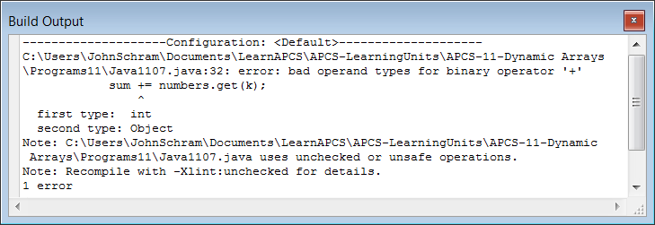
// Java1107.java
// This program demonstrates that <int> values stored into an <ArrayList> object must first be
// converted to <Integer> objects. <ArrayList> can only store objects members, not primitive data
// types. Initially, this program compiles, and executes. If you remove the comments from the program
// an attempt is made to add the values of the <numbers> object, which is not possible.
import java.util.ArrayList;
import java.util.Random;
public class Java1107
{
public static void main(String args[])
{
System.out.println();
System.out.println("Java1107.java\n");
Random rand = new Random(12345);
ArrayList numbers = new ArrayList();
for (int k = 1; k <= 48; k++)
{
int rndInt = (rand.nextInt(900) + 100);
numbers.add(new Integer(rndInt));
}
int sum = 0;
for (int k = 0; k < numbers.size(); k++)
{
sum += numbers.get(k);
}
System.out.println("Sum: " + sum);
System.out.println();
}
}
With the comment symbols removed the program does not compile.
ints can be added.
Integer objects cannot.
Do not be concerned about the “unchecked or unsafe operations” warning.

Slide 23
ArrayList and Primitive Data Types
The ArrayList class can only store Object values.
Primitive data type values can be stored indirectly using wrapper classes.
The Integer class
wraps int values.
The Double class
wraps double values.
The Boolean class
wraps boolean values.

Slide 24
Section 11.4
ArrayList
& Generics

Slide 25
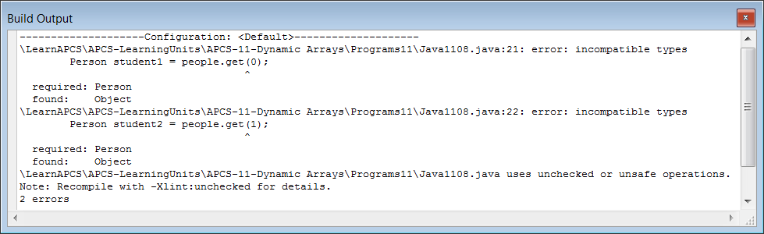
// Java1108.java
// This program has no output, which does not matter, because it does not compile.
// You will see two "incompatible types" syntax errors. This may seem strange
// because the <ArrayList> object stores <Person> objects.
import java.util.ArrayList;
public class Java1108
{
public static void main(String args[])
{
System.out.println();
System.out.println("Java1108.java\n");
ArrayList people = new ArrayList();
people.add(new Person("Joe",21));
people.add(new Person("Sue",20));
Person student1 = people.get(0);
Person student2 = people.get(1);
System.out.println();
}
}
class Person
{
private String name;
private int age;
public Person (String n, int a)
{
name = n;
age = a;
}
}

Slide 26
// Java1109.java
// This program compiles and there is still no output. Output is not the
// issue. Understanding the correct syntax involved does matter.
// In this case lines 22 and 23 cast to the <Person> class, which makes
// Java happy. Without casting the data types are unknown.
import java.util.ArrayList;
public class Java1109
{
public static void main(String args[])
{
System.out.println();
System.out.println("Java1109.java\n");
ArrayList people = new ArrayList();
people.add(new Person("Joe",21));
people.add(new Person("Sue",20));
Person student1 = (Person) people.get(0); // Line 22
Person student2 = (Person) people.get(1); // Line 23
System.out.println();
}
}
class Person
{
private String name;
private int age;
public Person (String n, int a)
{
name = n;
age = a;
}
}

Slide 27
// Java1110.java
// Since Java Version 5.0 the "casting" solution of the last program is so
// "old Java version". It is now possible to specify - at the time that the
// <ArrayList> object is constructed - what kind of object is stored.
// This is called "generics" and in this case Java knows it is <Person>.
import java.util.ArrayList;
public class Java1110
{
public static void main(String args[])
{
System.out.println();
System.out.println("Java1110.java\n");
ArrayList<Person> people = new ArrayList<Person>();
people.add(new Person("Joe",21));
people.add(new Person("Sue",20));
Person student1 = people.get(0);
Person student2 = people.get(1);
System.out.println();
}
}
class Person
{
private String name;
private int age;
public Person (String n, int a)
{
name = n;
age = a;
}
}

Slide 28
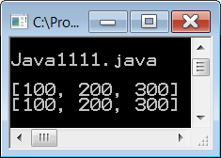
// Java1111.java
// This program shows another benefit of using generics.
// There are two <ArrayList> objects and both are constructed
// to store <Integer> values. After three values are entered
// in the <numbers1> object, those values are then assigned
// to <numbers2>, which works without problems.
import java.util.ArrayList;
public class Java1111
{
public static void main(String args[])
{
System.out.println();
System.out.println("Java1111.java\n");
ArrayList<Integer> numbers1 = new ArrayList<Integer>();
numbers1.add(new Integer(100));
numbers1.add(new Integer(200));
numbers1.add(new Integer(300));
System.out.println(numbers1);
ArrayList<Integer> numbers2 = new ArrayList<Integer>();
numbers2.add(numbers1.get(0));
numbers2.add(numbers1.get(1));
numbers2.add(numbers1.get(2));
System.out.println(numbers2);
System.out.println();
}
}

Slide 29
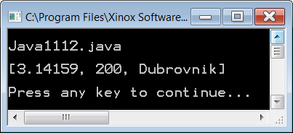
// Java1112.java
// Generics make sure that an array is in fact an array. An array
// is supposed to be a data structure with elements of the same type.
// This program example - which does not use generics - allows the
// list array to store three different data types.
import java.util.ArrayList;
public class Java1112
{
public static void main(String args[])
{
System.out.println();
System.out.println("Java1112.java\n");
ArrayList list = new ArrayList();
list.add(new Double(3.14159));
list.add(new Integer(200));
list.add(new String("Dubrovnik"));
System.out.println(list);
System.out.println();
}
}
This violates the definition of an array.

Slide 30
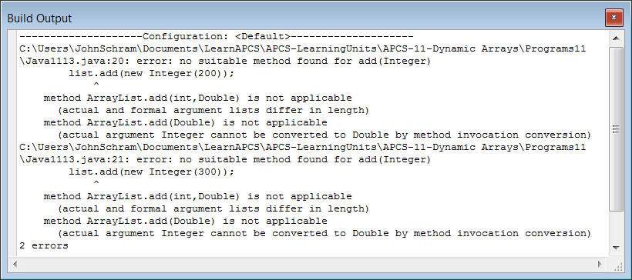
// Java1113.java
// Once generics are used, Java becomes very picky. If you want to create
// an <ArrayList> object to store <Double> values, such as is shown below,
// then only <Double> values must be added. The attempt to add one <Double>,
// one <Integer> and one <String> object results in two errors.
import java.util.ArrayList;
public class Java1113
{
public static void main(String args[])
{
System.out.println();
System.out.println("Java1113.java\n");
ArrayList<Double> list = new ArrayList<Double>();
list.add(new Double(3.14159));
list.add(new Integer(200));
list.add(new String("Dubrovnik"));
System.out.println(list);
System.out.println();
}
}

Slide 31
Section 11.5
ArrayList and the
Enhanced for Loop

Slide 32
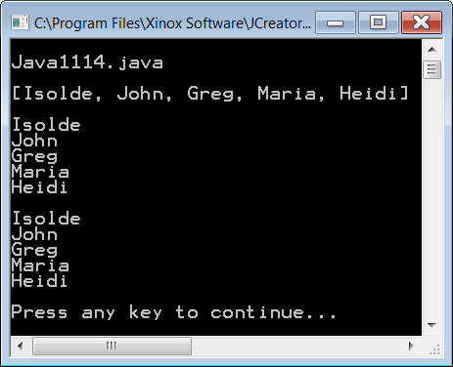
// Java1114.java
// The final program in this chapter shows three ways to display the members of an <ArrayList> object.
// Note that the enhanced <for> loop works very well with <ArrayList> objects.
import java.util.ArrayList;
public class Java1114
{
public static void main(String args[])
{
System.out.println();
System.out.println("Java1114.java\n");
ArrayList<String> names = new ArrayList<String>();
names.add("Isolde");
names.add("John");
names.add("Greg");
names.add("Maria");
names.add("Heidi");
System.out.println(names);
System.out.println();
for (int index = 0; index < names.size(); index++)
System.out.println(names.get(index));
System.out.println();
for (String name: names)
System.out.println(name);
System.out.println();
}
}

Slide 33
Section 11.6
Two-Dimensional
Dynamic Arrays

Slide 34
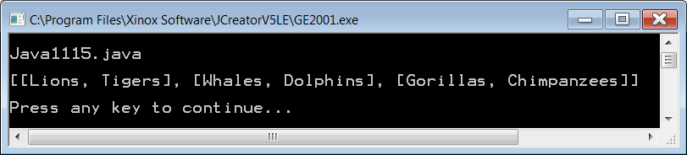
// Java1115.java
// It is possible for each member of an <ArrayList> object to be an <ArrayList> object.
// This creates an array of arrays or two-dimensional dynamic array.
// In this example you get an <ArrayList> of <ArrayList> member of <String> members.
// Observe the nested generics syntax of ArrayList<ArrayList<String>>.
import java.util.ArrayList;
public class Java1115
{
public static void main (String args[])
{
System.out.println();
System.out.println("Java1115.java\n");
ArrayList<String> cats = new ArrayList<String>();
cats.add("Lions");
cats.add("Tigers");
ArrayList<String> swimmers = new ArrayList<String>();
swimmers.add("Whales");
swimmers.add("Dolphins");
ArrayList<String> primates = new ArrayList<String>();
primates.add("Gorillas");
primates.add("Chimpanzees");
ArrayList<ArrayList<String>> mammals = new ArrayList<ArrayList<String>>();
mammals.add(cats);
mammals.add(swimmers);
mammals.add(primates);
System.out.println(mammals);
System.out.println();
}
}

Slide 35
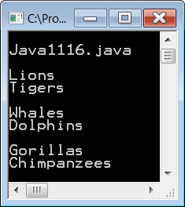
// Java1116.java
// This program demonstrates how to display the elements of a two-dimensional dynamic array
// and it also shows how to use a set of nested <for..each> loop structures.
System.out.println();
System.out.println("Java1116.java\n");
ArrayList<String> cats = new ArrayList<String>();
cats.add("Lions");
cats.add("Tigers");
ArrayList<String> swimmers = new ArrayList<String>();
swimmers.add("Whales");
swimmers.add("Dolphins");
ArrayList<String> primates = new ArrayList<String>();
primates.add("Gorillas");
primates.add("Chimpanzees");
ArrayList<ArrayList<String>> mammals = new ArrayList<ArrayList<String>>();
mammals.add(cats);
mammals.add(swimmers);
mammals.add(primates);
for (ArrayList<String> mammal: mammals)
{
for (String animal: mammal)
System.out.println(animal);
System.out.println();
}

Slide 36
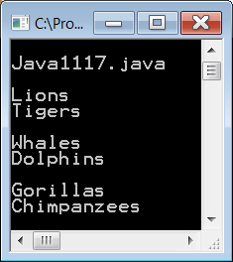
// Java1117.java
// This program example demonstrates how to use the original <for>
// loop structure to display dynamic two-dimensional arrays.
System.out.println();
System.out.println("Java1117.java\n");
ArrayList<String> cats = new ArrayList<String>();
cats.add("Lions");
cats.add("Tigers");
ArrayList<String> swimmers = new ArrayList<String>();
swimmers.add("Whales");
swimmers.add("Dolphins");
ArrayList<String> primates = new ArrayList<String>();
primates.add("Gorillas");
primates.add("Chimpanzees");
ArrayList<ArrayList<String>> mammals = new ArrayList<ArrayList<String>>();
mammals.add(cats);
mammals.add(swimmers);
mammals.add(primates);
for (int row = 0; row < mammals.size(); row++)
{
for (int col = 0; col < mammals.get(row).size(); col++)
System.out.println(mammals.get(row).get(col));
System.out.println();
}

Slide 37
Section 11.7
Actor, the SuperClass for
Most GridWorld Objects

Slide 38
Actor Class and Location Class Significance
The Actor class is the super class for all the GridWorld class objects displayed on the grid display.
The Location class works with the Actor class to place objects on the grid at the desired row and col locations.

Slide 39
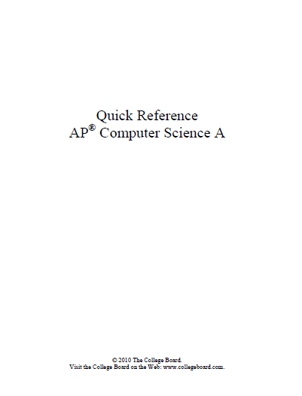
GridWorld Case Study Quick Reference Note
You are not expected to memorize all the testable classes and methods of the GWCS.
A Quick Reference Guide is provided during the APCS Exam.
You need to be very familiar with the guide, such that - even if you cannot remember everything - you know where to find the information quickly in your guide.

Slide 40
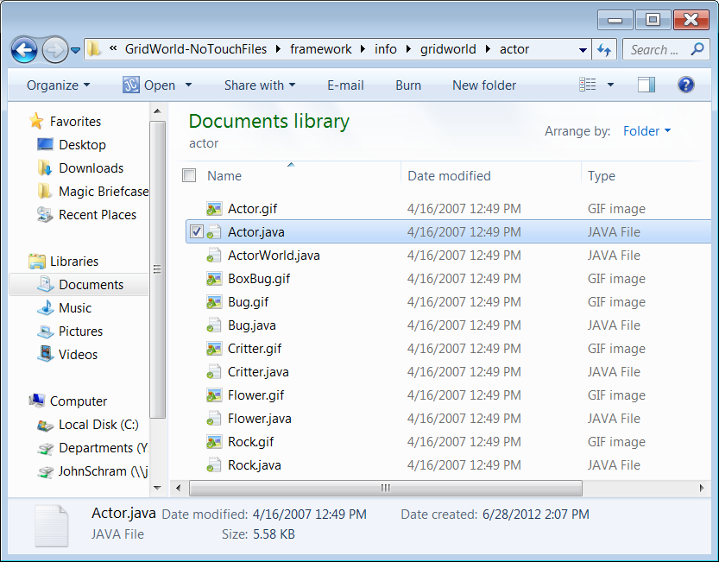
An Overview of the Actor class

Slide 41
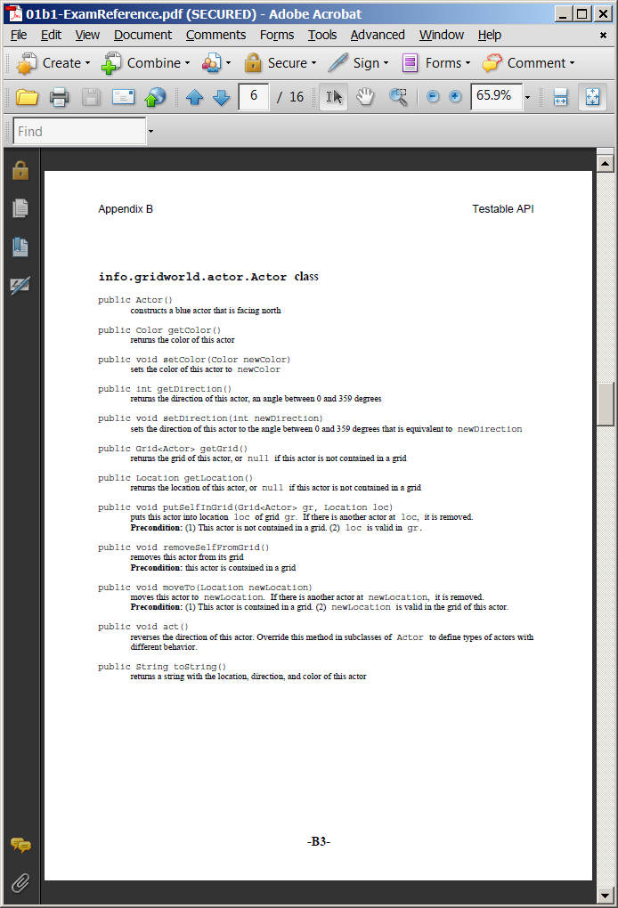
Actor class API – From the Quick Reference Guide

Slide 42
Actor class Attributes
private Grid<Actor> grid;
private Location location;
private int direction;
private Color color;
grid | stores the name of the Actor's Grid or null if the object is not part of a Grid.
location | stores the Location (row,col) coordinate of the Actor object.
direction | stores the direction that the Actor object faces on the grid.
color | stores the color of the Actor object.

Slide 43
Actor Constructor Method
public Actor()
{
color = Color.BLUE;
direction = Location.NORTH;
grid = null;
location = null;
}

Slide 44
getColor return Method
public Color getColor()
{
return color;
}
setColor void Method
public void setColor(Color newColor)
{
color = newColor;
}

Slide 45
getDirection return Method
public int getDirection()
{
return direction;
}
setDirection void Method
public void setDirection(int newDirection)
{
direction = newDirection % Location.FULL_CIRCLE;
if (direction < 0)
direction += Location.FULL_CIRCLE;
}

Slide 46
getGrid return Method
public Grid<Actor> getGrid()
{
return grid;
}
getLocation return Method
public Location getLocation()
{
return location;
}

Slide 47
putSelfInGrid void Method
public void putSelfInGrid(Grid<Actor> gr, Location loc)
{
if (grid != null)
throw new IllegalStateException("This actor is already contained in a grid.");
Actor actor = gr.get(loc);
if (actor != null)
actor.removeSelfFromGrid();
gr.put(loc, this);
grid = gr;
location = loc;
}

Slide 48
removeSelfFromGrid void Method
public void removeSelfFromGrid()
{
if (grid == null)
throw new IllegalStateException("This actor is not contained in a grid.");
if (grid.get(location) != this)
throw new IllegalStateException("The grid contains a different actor at location"
+ location + ".");
grid.remove(location);
grid = null;
location = null;
}

Slide 49
act void Method
public void act()
{
setDirection(getDirection() + Location.HALF_CIRCLE);
}

Slide 50
moveTo void Method
public void moveTo(Location newLocation)
{
if (grid == null)
throw new IllegalStateException("This actor is not in a grid.");
if (grid.get(location) != this)
throw new IllegalStateException("The grid contains a different actor at location "
+ location + ".");
if (!grid.isValid(newLocation))
throw new IllegalArgumentException("Location " + newLocation
+ " is not valid.");
if (newLocation.equals(location))
return;
grid.remove(location);
Actor other = grid.get(newLocation);
if (other != null)
other.removeSelfFromGrid();
location = newLocation;
grid.put(location, this);
}

Slide 51
toString return Method
public String toString()
{
return getClass().getName() + "[location=" + location +
",direction=" + direction + ",color=" + color + "]";
}

Slide 52
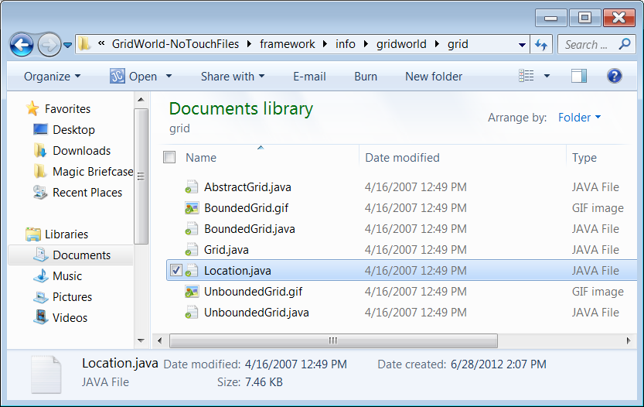
An Overview of the Location class

Slide 53
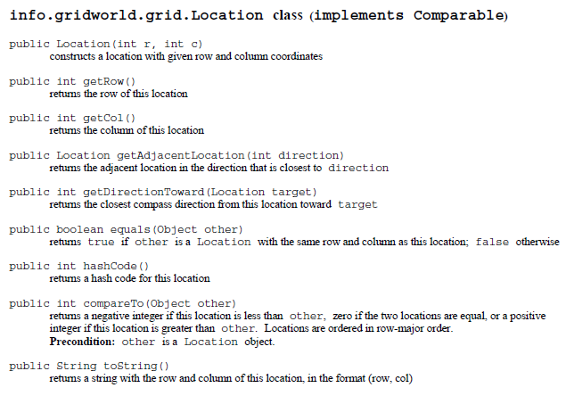
Location class API – From the Quick Reference Guide

Slide 54
Location class private Attributes
private int row; // row location in grid
private int col; // column location in grid

Slide 55
Location class public Attributes
public static final int NORTH = 0;
public static final int NORTHEAST = 45;
public static final int EAST = 90;
public static final int SOUTHEAST = 135;
public static final int SOUTH = 180;
public static final int SOUTHWEST = 225;
public static final int WEST = 270;
public static final int NORTHWEST = 315
While attributes are normally declared private, these can be declared public because they are also declared final. This gives you access to the constant values in the same way that you can access Math.PI.

Slide 56
Location class more public Attributes
public static final int LEFT = -90;
public static final int RIGHT = 90;
public static final int HALF_LEFT = -45;
public static final int HALF_RIGHT = 45;
public static final int FULL_CIRCLE = 360;
public static final int HALF_CIRCLE = 180;
public static final int AHEAD = 0;
While attributes are normally declared private, these can be declared public because they are also declared final. This gives you access to the constant values in the same way that you can access Math.PI.

Slide 57
static Variables
Static or class variables have recently been added to the AP Computer Science Examination.
Static variables can be accessed anywhere in the program without the construction of an object. Only the class name is required, as is shown inside the turn method of the Bug class below. This means that a Bug object makes a 45 degree, clockwise turn whenever the turn method is called.
public void turn()
{
setDirection(getDirection() + Location.HALF_RIGHT);
}

Slide 58
Location Constructor Method
public Location(int r, int c)
{
row = r;
col = c;
}

Slide 59
getRow return Method
public int getRow()
{
return row;
}
getCol return Method
public int getRow()
{
return col;
}

Slide 60
equals return Method
public boolean equals(Object other)
{
if (!(other instanceof Location))
return false;
Location otherLoc = (Location) other;
return getRow() == otherLoc.getRow() &&
getCol() == otherLoc.getCol();
}

Slide 61
getAdjacentLocation return Method
public Location getAdjacentLocation(int direction)
{
int adjustedDirection = (direction + HALF_RIGHT / 2) % FULL_CIRCLE;
if (adjustedDirection < 0)
adjustedDirection += FULL_CIRCLE;
adjustedDirection = (adjustedDirection / HALF_RIGHT) * HALF_RIGHT;
int dc = 0; int dr = 0;
if (adjustedDirection == EAST)
dc = 1;
else if (adjustedDirection == SOUTHEAST)
{ dc = 1; dr = 1; }
else if (adjustedDirection == SOUTH)
dr = 1;
else if (adjustedDirection == SOUTHWEST)
{ dc = -1; dr = 1; }
else if (adjustedDirection == WEST)
dc = -1;
else if (adjustedDirection == NORTHWEST)
{ dc = -1; dr = -1; }
else if (adjustedDirection == NORTH)
dr = -1;
else if (adjustedDirection == NORTHEAST)
{ dc = 1; dr = -1; }
return new Location(getRow() + dr, getCol() + dc);
}

Slide 62
getDirectionToward return Method
public int getDirectionToward(Location target)
{
int dx = target.getCol() - getCol();
int dy = target.getRow() - getRow();
int angle = (int) Math.toDegrees(Math.atan2(-dy, dx));
// mathematical angle is counterclockwise from x-axis,
// compass angle is clockwise from y-axis
int compassAngle = RIGHT - angle;
// prepare for truncating division by 45 degrees
compassAngle += HALF_RIGHT / 2;
// wrap negative angles
if (compassAngle < 0)
compassAngle += FULL_CIRCLE;
// round to nearest multiple of 45
return (compassAngle / HALF_RIGHT) * HALF_RIGHT;
}

Slide 63
hashCode return Method
public int hashcode()
{
return getRow() * 3737 + getCol();
}

Slide 64
getDirection return Method
public int compareTo(Object other)
{
Location otherLoc = (Location) other;
if (getRow() < otherLoc.getRow())
return -1;
if (getRow() > otherLoc.getRow())
return 1;
if (getCol() < otherLoc.getCol())
return -1;
if (getCol() > otherLoc.getCol())
return 1;
return 0;
}

Slide 65


toString return Method
public String toString()
{
return "(" + getRow() + ", " + getCol() + ")";
}

